Slide 1
British values
By Monty.B and Barnaby.B

Slide 2
Rule of law
Now sometimes people think that the law is unfair but if you think of it imagine what the world would be like without law. In britain we try to make rules as fair as possible but not too relaxed otherwise as i said before it would be CHAOS so just remember the law isn’t unfair

Slide 3
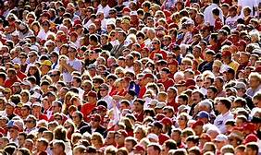
The public
In England we are a Democracy so at means that the public votes for who runs
the country. There are many many constituencies in england each one has MP, where as in Russia and north korea they have Dictatorships were only they make decisions about what happens.
If you have a dictator telling you what to do there taking away soooooo much freedom from you its incredibly horrible.

Slide 4

Public voting rights
Everybody has a right to vote if they’re over the
age of 18 where as on august 1920 women couldn’t
Vote because of their gender! Rules were sooooo
Unfair back in the day, so the suffragettes took a stand and protested for years and years. But
after a while it started getting violent. They rampaged shops and markets and then they were
sent to prison but they did not stop oh no they carried on protesting until the men gave in and
women were allowed to vote so that's the story of how women are now allowed to vote!

Slide 5
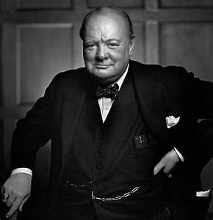
perseverance
Perseverance is such an important thing to have in life because it helps you push past your fear and try new things and most of all keep on trying. What did winston churchill say when we were losing the war against the watch this video of his famous speech and you will understand german ttps://youtu.be/s_LncVnecLA

Slide 6
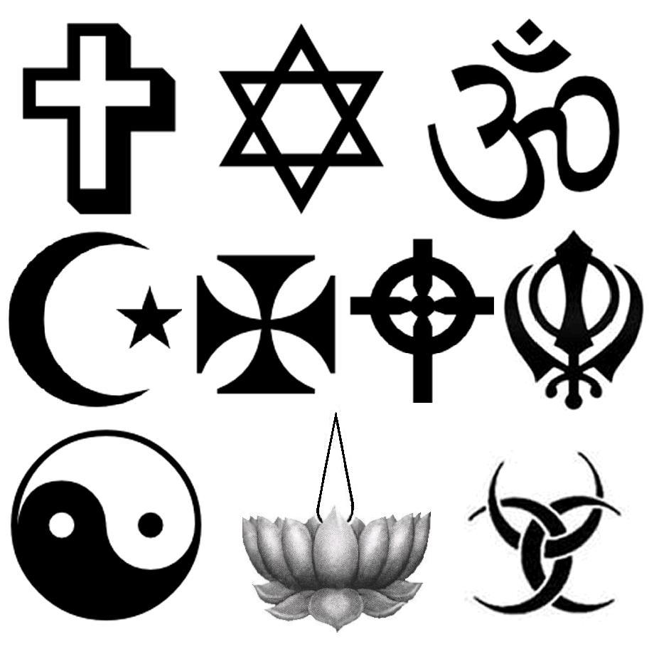
Enabling other religions
In britain you are free to follow any religion you want and you are not criticised about it were as in other places in the world you are not allowed to follow whatever religion you want.

