Slide 1

British Values
By Sophie and Hatty

Slide 2
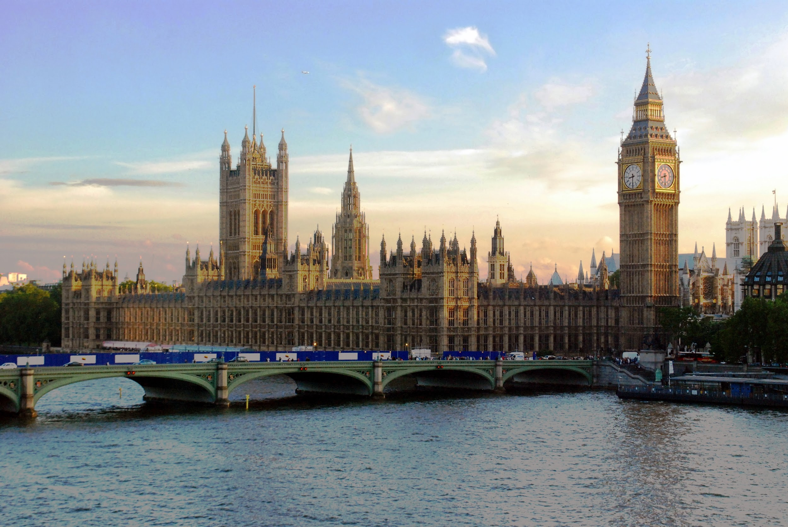
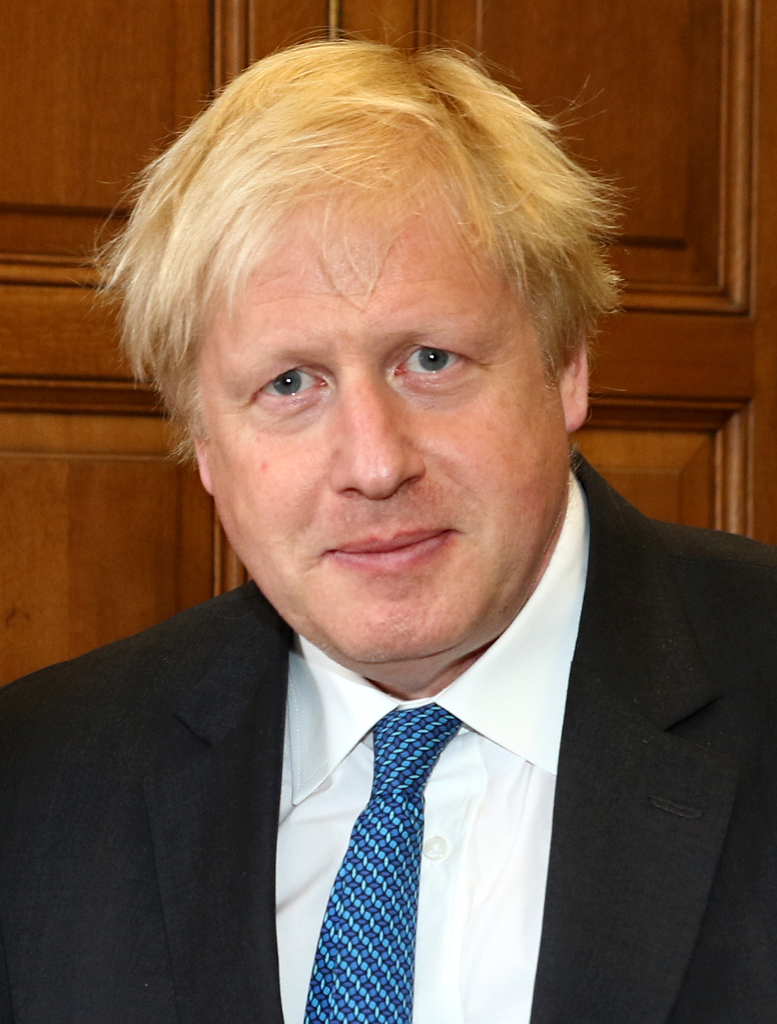
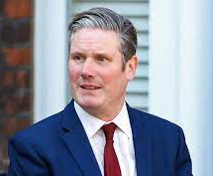
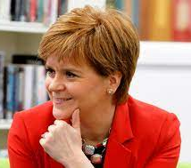
Leaders and Parties
Boris Johnson is our Prime Minister and the leader of the Conservatives. Nicola Sturgeon is the First Minister of Scotland Scotland and leader of SNP. Sir Keir Starmer is the leader of the Labour party.

Slide 3


Individual Liberty
Individual liberty means being able to have the right to have your own opinions and to speak freely, to vote and move around the world. “Having the freedom to do things that I want in a way that I would want to do them, rather than being forced to do something or being restricted by one power.” By A Law Student.

Slide 4
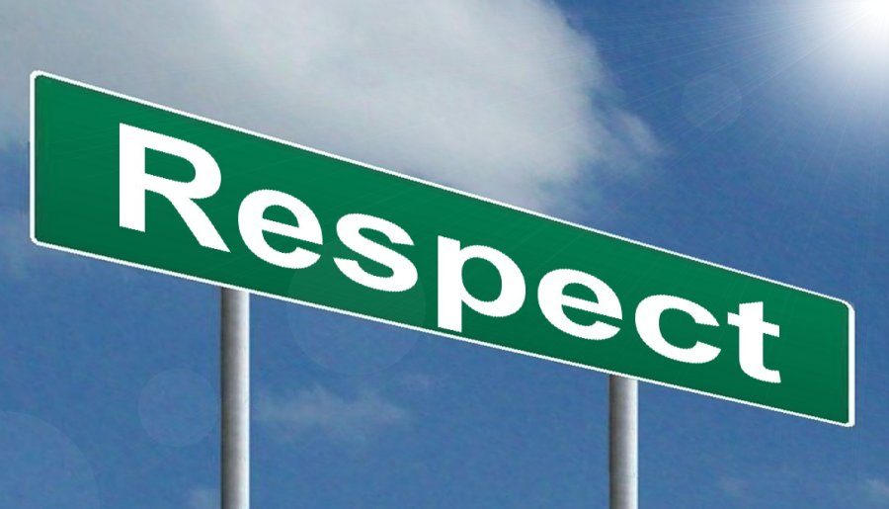
Respect
Respect is a important quality to have and show to others but it is just as important to respect ourselves the same. We can show respect in many different ways through different actions and through our voices. In different places you can show different signs of respect. In school you could show respect by waiting in line, trying your best in a hard subject or using good manners. On a walk when you see someone give them a little smile or a wave.

Slide 5

Resilience
Resilience means the ability to bounce back (to recover quickly). When you find yourself faced with a problem, you can not manage it well or you can be resilient and figure out how to get rid of it. Sometimes when you try to fix it, it ends up going wrong and you don’t know what to do, so what then? In a situation like this you could see if there's someone around to help you with your problem.

Slide 6

British Government Laws
Tolerance of Different Cultures and Religions
Rule of Law
Mutual Respect
Individual Liberty
Democracy

