Slide 1

British Values
Oliver & Oscar T
We respect the culture and beliefs of others
We treat everybody equally

Slide 2

What is Democracy?
Democracy comes from Greek words that mean “rule by the people.”
In a democracy the people have a say in how the government is run
They do this by voting
Democracies are different from dictatorships
In a democracy we follow the law of our country

Slide 3
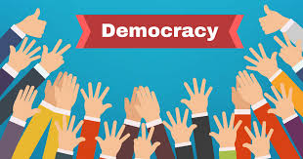
What does Democracy mean?
We have a system of government called democracy where everyone is equal
We hold an election to choose who will represent us
We protect the rights of all people
A democracy depends on laws

Slide 4
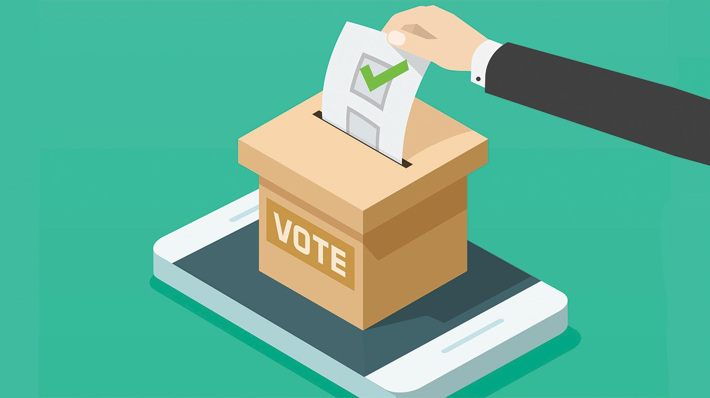
Voting
Women weren’t allowed to vote until 1918
You have to be over 18 to vote
You have to go to a polling station to vote
People cast their ballot in a booth so it’s secret

Slide 5

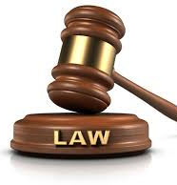
Why do we have laws?
We have laws because it keeps us safe
Speed laws exist so we drive safely
Without laws people can do whatever they like, and they might harm others

Slide 6
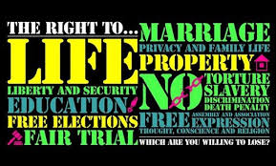
What is Individual Liberty?
It means you are free to do what is right
Not to do whatever you want
We should not prevent others individual liberty
We need to be understanding of others and not just think of ourselves
Value everyone’s opinion

Slide 7
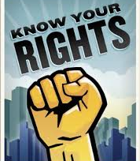
What are your rights?
Right to an education
Freedom to have your own thoughts and beliefs
Right to be safe
Right to not be discriminated against
Freedom from slavery

Slide 8
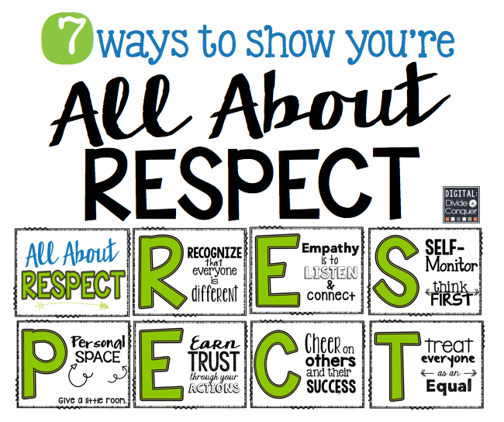
What is Respect?
Thinking about other people and their feelings
How can we show respect at school:
  Listening to others
  Following school rules
  Having good manners
  Being kind to each other
  Include everyone

Slide 9
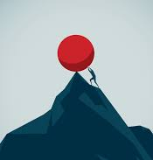
What is Resilience?
Resilience is being able to recover from difficulties
How can we build resilience:
  Learn from our mistakes
  Keep trying and don’t give up
  Work hard but ask for help when you need it
  Keep calm and be kind

Slide 10
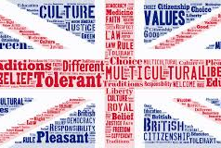
Summary of British Values

