Slide 1
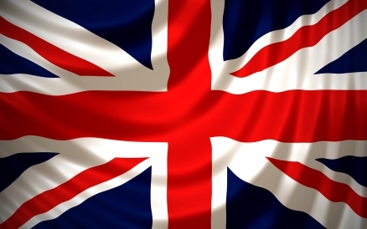
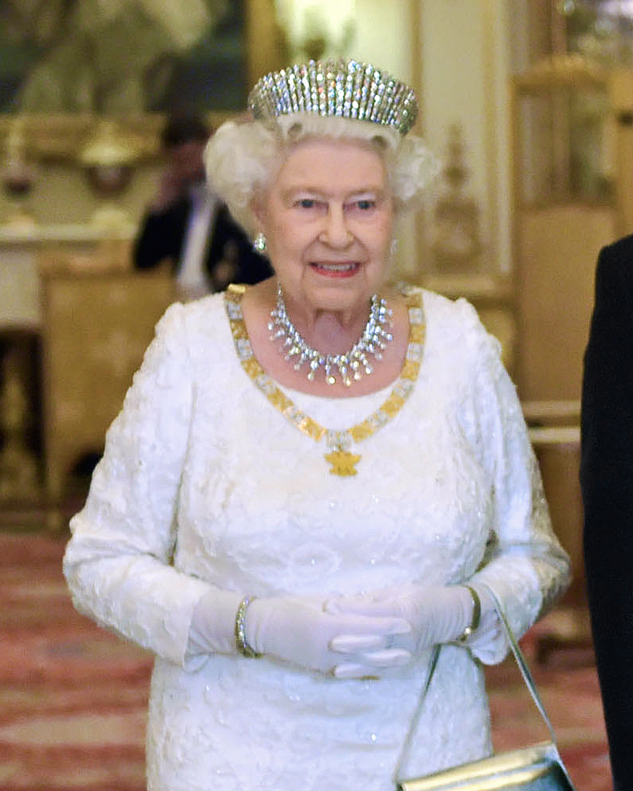


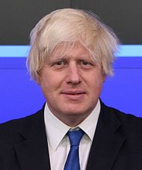
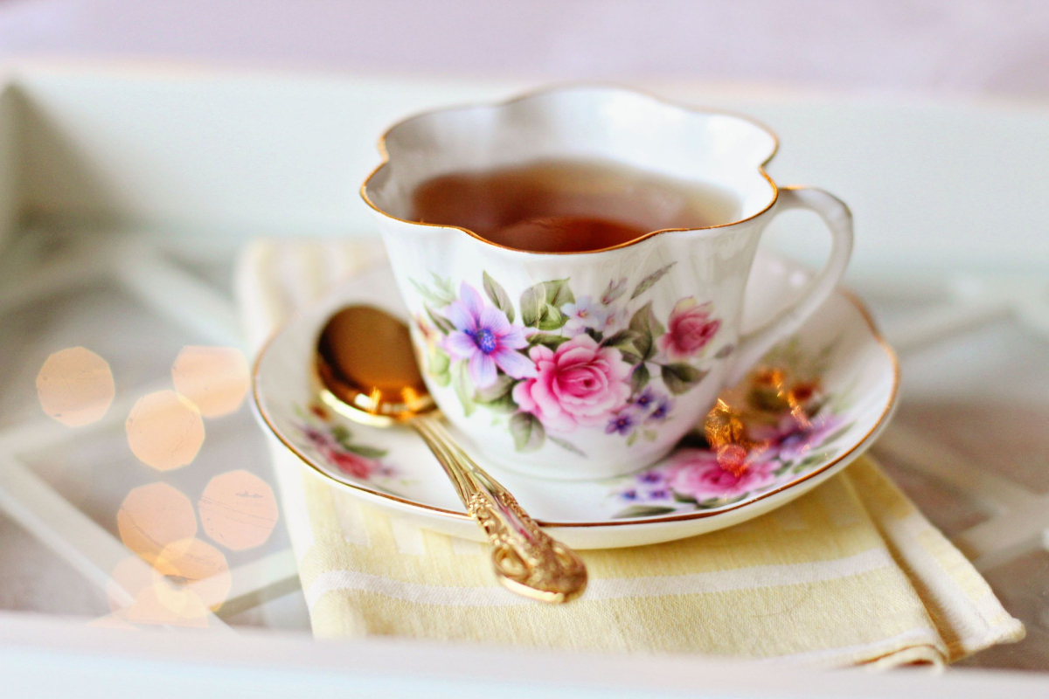
British Values
British Values
By Amber And Alice And Violet And Alannah
By Amber , Violet , Alannah ,Alice
This

Slide 2
Leaders
Boris Johnson ,Who is 56, is part of the conservative party and is prime minister of the UK.
Keir Starmer ,Who is 58, is part of the Labour party and leader of the Opposition since 2020.
Nicola Sturgeon ,Who is 50, is part of the Scottish national party.

Slide 3
POLITICAL PARTY
What is political party?
A political party is an organization that coordinates candidates to compete in a country's election.

Slide 4
ELECTION DAY
Election Day is also called Polling Day.
On Election day, people go to a polling station to vote.
One person will go into a private booth and cast there ballot so nobody can see who they are voting for.
At the end of Election Day the votes are counted up and the person with the most votes(Majority) is declared the Winner.
The Leader of the winning party becomes the new Prime Minister

Slide 5
Woman’s right to vote
In 1903 Emmeline Pankhurst started campaigning for woman’s right to vote with her 3 daughters(Christabel, Sylvia and Adela) Over time, more women came to join in the fight for women's right to vote. This was called the suffrage movement.
Women got more and more aggressive as more went to jail they wouldn’t give up this fight! Some even tied themselves to gates.

Slide 6
Individual liberty
Individual liberty means you all have your own freedom to do what we want within reason. If we use this freedom irresponsibly it could be taken away from us like: Getting grounded, Put in prison or just getting sent to your room. All of these take away our freedom.

Slide 7
Democracy
They are loads of ways that people can cast there vote such as: mail your MP, mail the government, or go to your local polling station on election day.

Slide 8
House and accessories
Family and Friends and Pets
If being happy is important to you try this : instead of regretting things you lack celebrate all the things you have
Food and Water
Hygiene

Slide 9
problems
Dealing with problems is a key part to life. If there is a small problem just leaving it there it can turn in to a major problem, even though you might not think it. Make sure not to panic or worry when you come across a problem just make sure you face the problem. When you face the problem it will feel better at the end.

Slide 10
RESILIENCE
Resilience means to recover from tough times or difficulties. An example of this is when a pet or person in your life dies and you have to move on.

Slide 11
RESPECT
Respect is crucial in life. Respect yourself as well as others. Don’t look at the bad things in life look at the positive things . Bad things happen in everyone's life but good and happy things also happen.

Slide 12
Helpful Message
Don’t let fear overtake you, don’t let the bad things get you down, let the happy things keep you up

Slide 13
Tea
What does tea mean to British people?
The British people apparently drink about 60 million cups of tea each year. It came a habit for British life. The Queen likes to have a nice cup of tea.

Slide 14
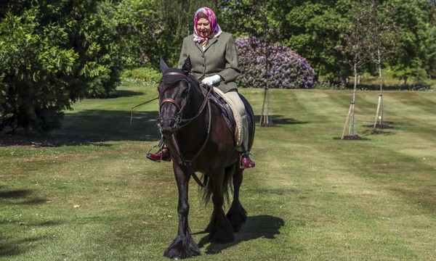
THE Queen
The Queen ,who is 94 years old, was born on the 21st April 1926. Her full name is Elisabeth Alexandra Mary Windsor. The Queen rides at Windsor Castle and here is a photo of her riding.

Slide 15
Thank You For Watching We Hope you enjoyed
This Photo by Unknown Author is licensed under CC BY-SA-NC

