Slide 1
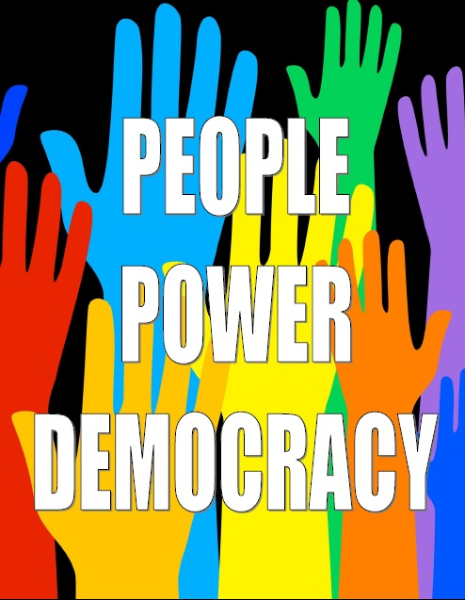

By hazel Taylor and Maddie.
b

Slide 2

What is democracy

Slide 3
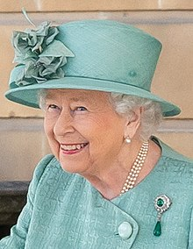
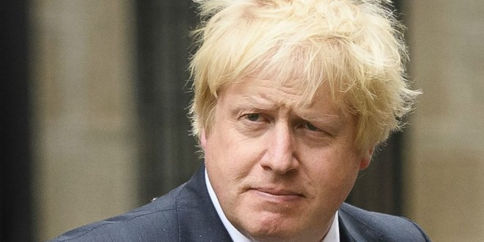
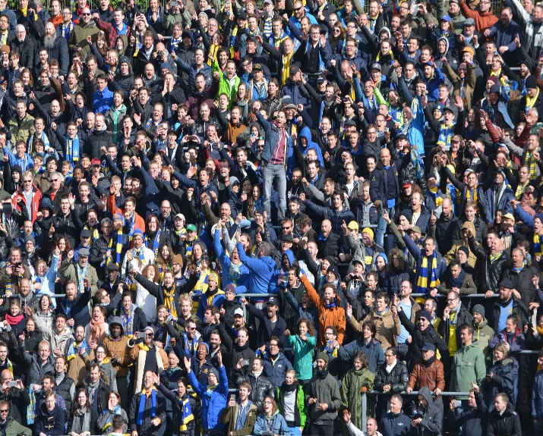
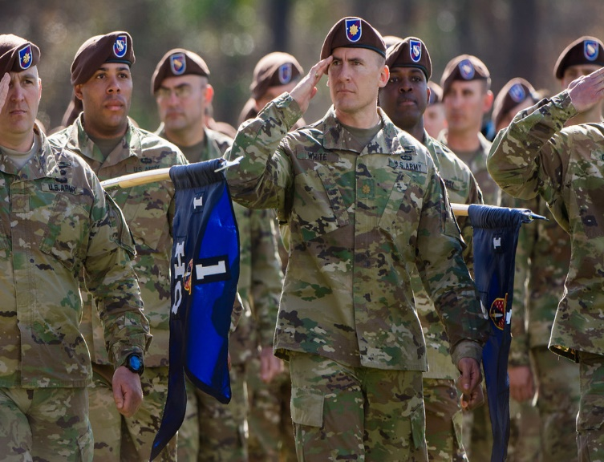
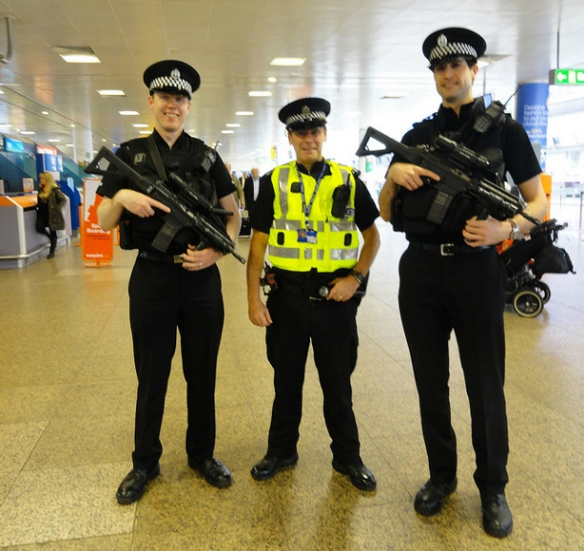
Who rules the UK
We know we have rules but there are specific people who manage and create them.
Queen
Priminister
Police
Army force
The UK,s people

Slide 4
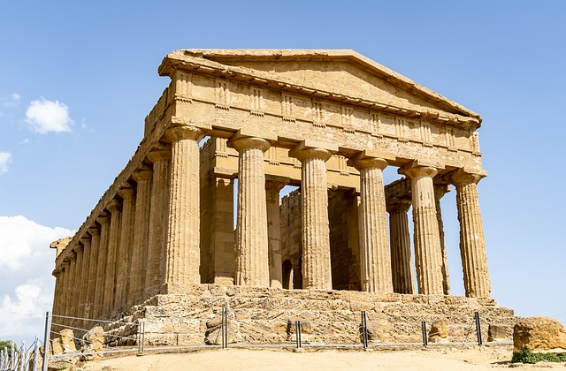
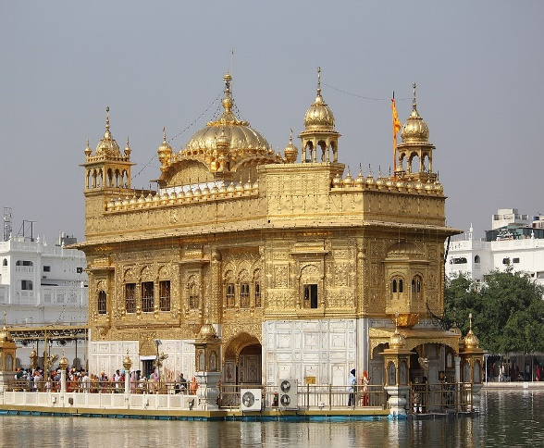
What does democracy represent?
Democracy means ruled by the people
We have a system named democracy.
It comes from the Greek words such as dȇmos means people kratos means strength
The idea was made in Greece around 507 BC

Slide 5
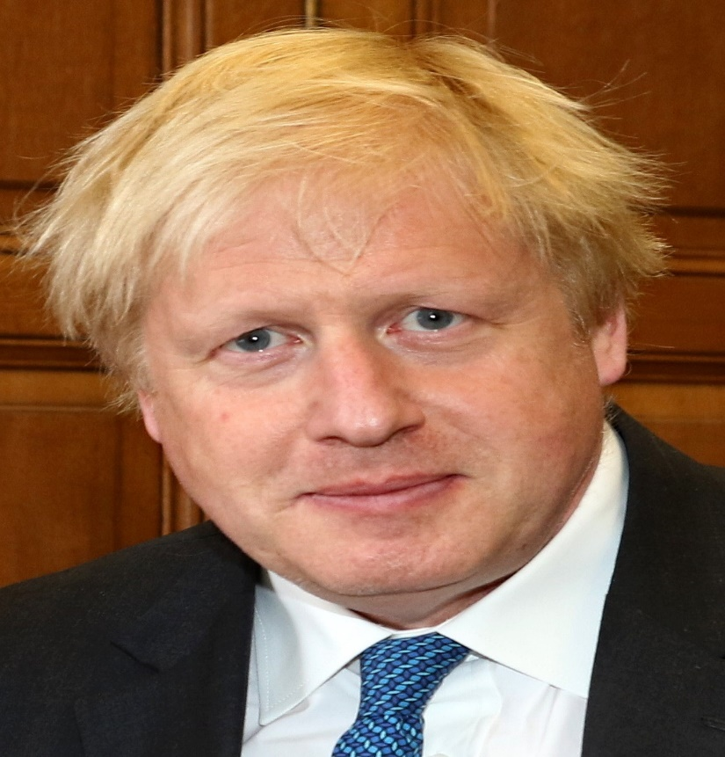
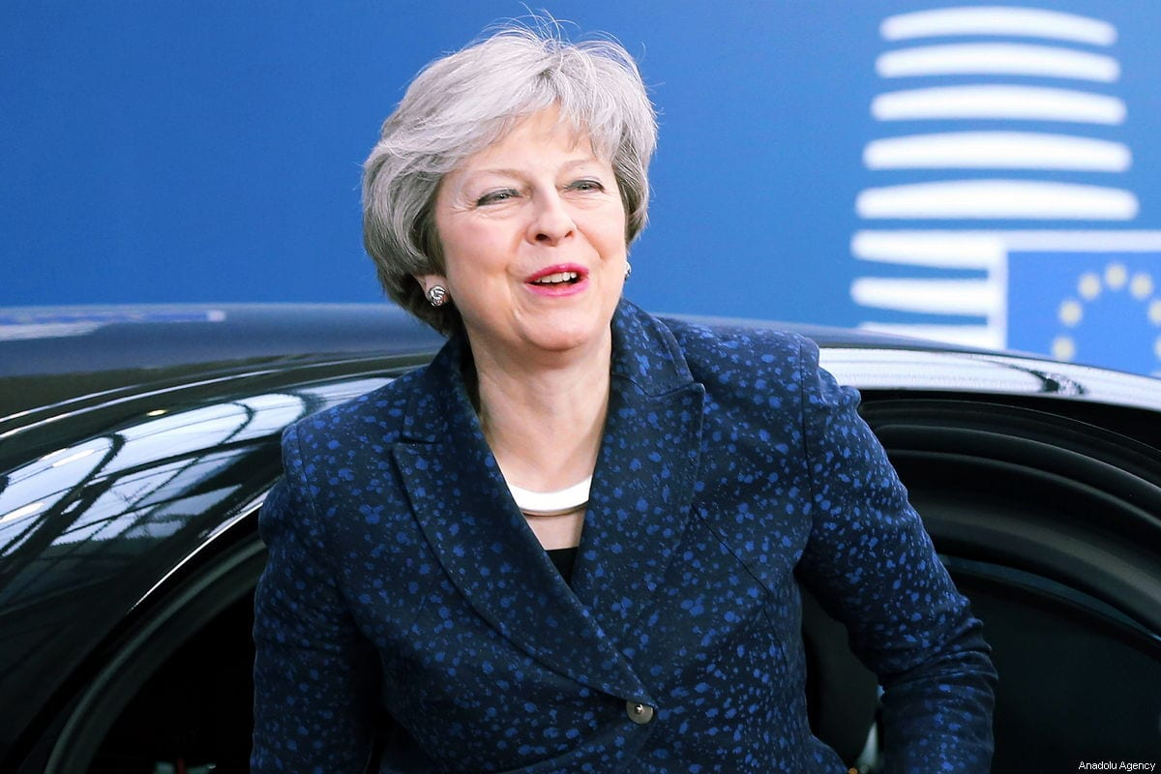
If we all ruled, it would be crazy! Everything would be out of hand! The world would be wild.
We have an election to choose someone to represent us.

Slide 6

General election
In The UK general election happens every 5 years. if you want to become a MP you have to stand as a candidate. You have to advertise yourself to get votes. You have to be 18 or over to be able to vote. In the general election people that try to be a MP are normaly part of political party.

Slide 7
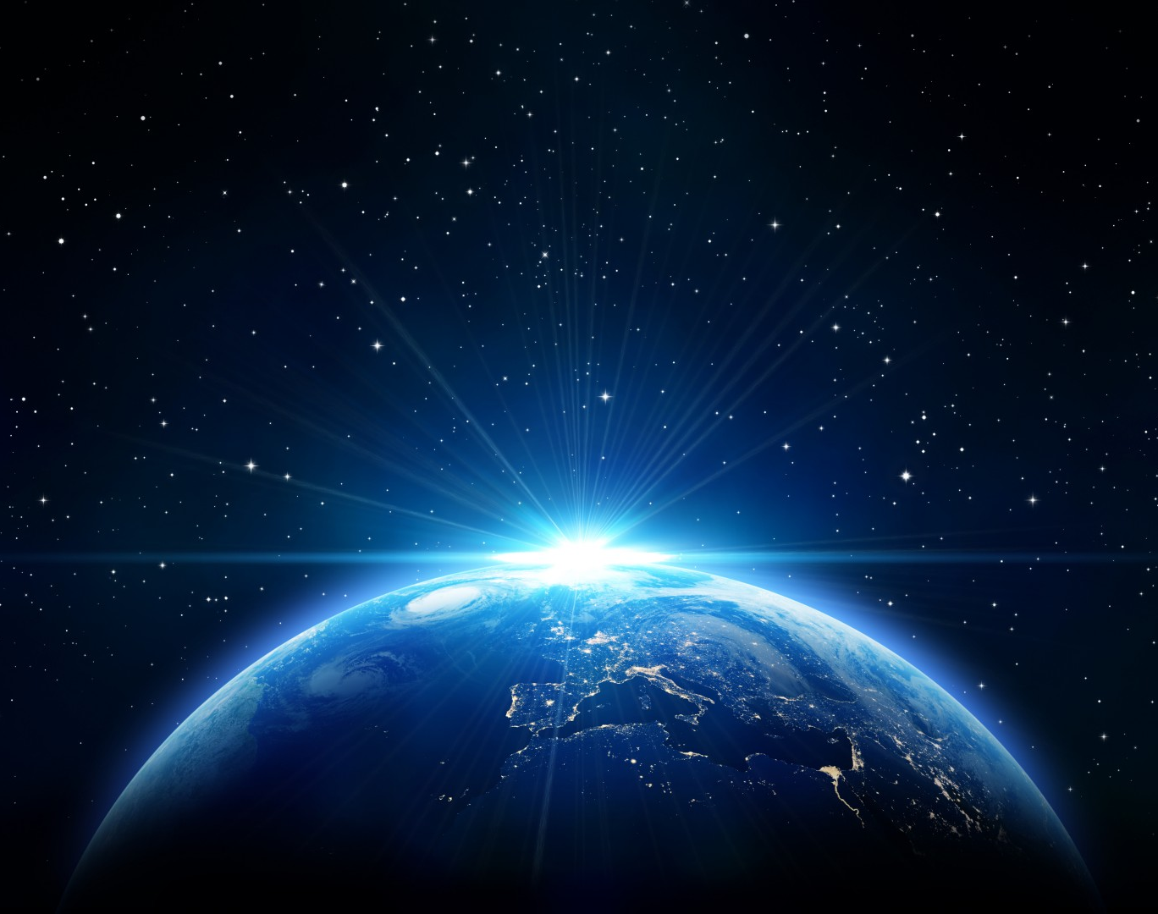
Not all country’s have democracy
China, Egypt and Saudi Arabia north Korea all don’t have democracy.

Slide 8
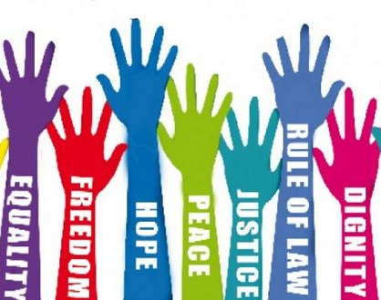
individual liberty
Individual liberty means you can make your own choices in life for example, eat what you want drink what you want and not let people tell you what to do.

Slide 9
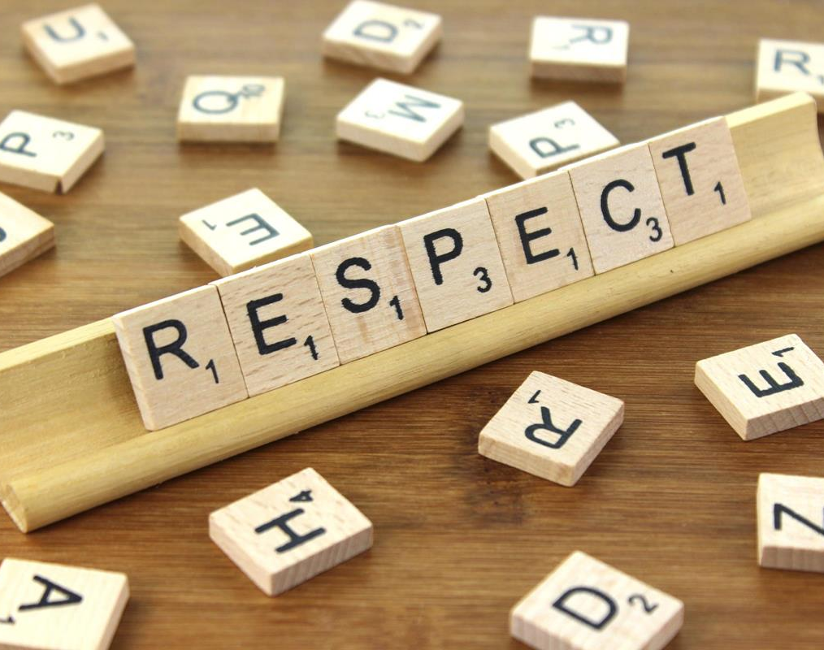
Respect
Respect is caring about others thoughts and feelings, opinions and excepting that other people like different things.
You should always respect others. Take notice of the people around you. And be aware of others around you because were all equaly important

Slide 10
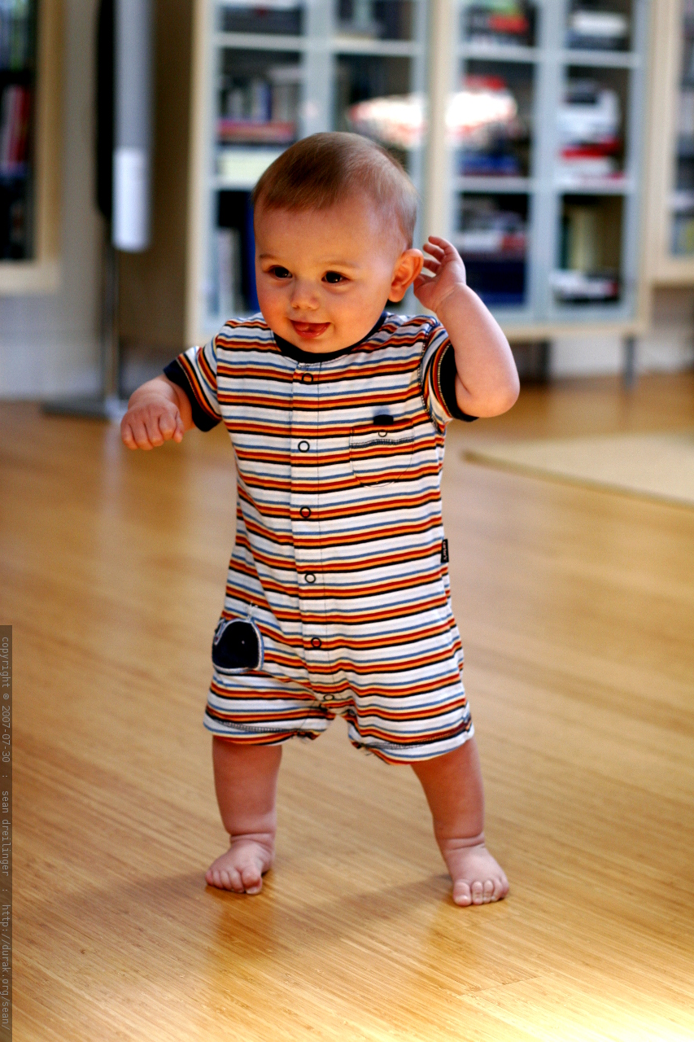
Resilience
Resilience is like a material that can spring back into its normal form if we are in an uncomfortable position and you cant bounce back into shape you need to develop more resilience.
We can increase our resilience by:
Learning from our mistakes
Working harder
Asking for help
Taking a break
Keep trying
Being kind to yourself
Staying calm
Seeing the funny side
Looking at things in a different way

Slide 11

Thankyou for listening to our power point
we hope you Enjoyed

