Slide 1

I’M DREAMING OF a HOLIDAY TO.... HAWAII!
Let’s dive in!

Slide 2

✈️
DISTANCE:
Hawaii is approximately 7,259 miles away from Hertfordshire or roughly 13,300km.
By flying, it would take you about 22 hours and 5 minutes (or longer!) to get there.
That’s nearly a whole day of travelling! I hope they’ve got films on, in the plane!

Slide 3

👩‍👩‍👧‍👦
Population:
1.4 million people inhabit Hawaii – that’s a lot of people!
Weirdly, 10.4 million people visit Hawaii each year!
To give you an idea how small the population is in
Hawaii, the UK’s population is 67 million!

Slide 4

⏰
Time:
Hawaii is around four hours ahead of us, e.g. if the time here was 14:00 (2:00pm), in Hawaii, it’s about 18:00 (6:00pm)

Slide 5

💷
Money:
In Hawaii, instead of pounds, they use U.S Dollar (USD)
For comparison, £1 is equal to $1.24
For example, if, here, an ice cream cost £3.00, in Hawaii, it would cost $3.72.

Slide 6
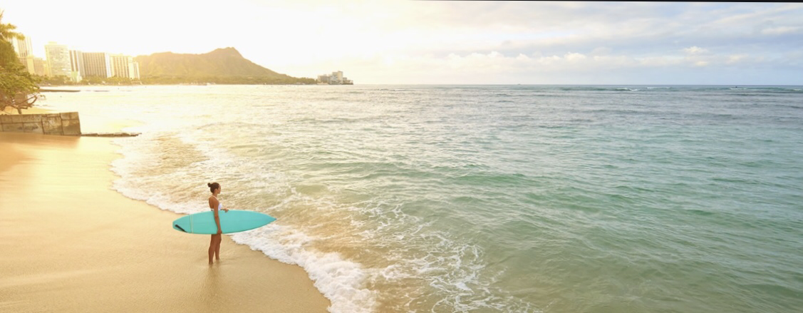
Temperatures:
The average daytime summer temperature at sea level is 85° F (29.4° C), whereas, the average temperature at night in Hawaii is roughly 75° F.

Slide 7
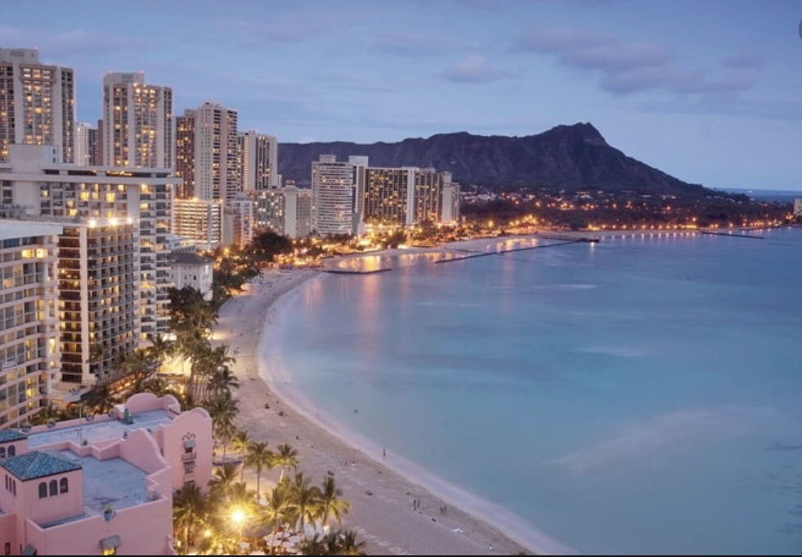
THE END!
Hope you enjoyed!

