Slide 1

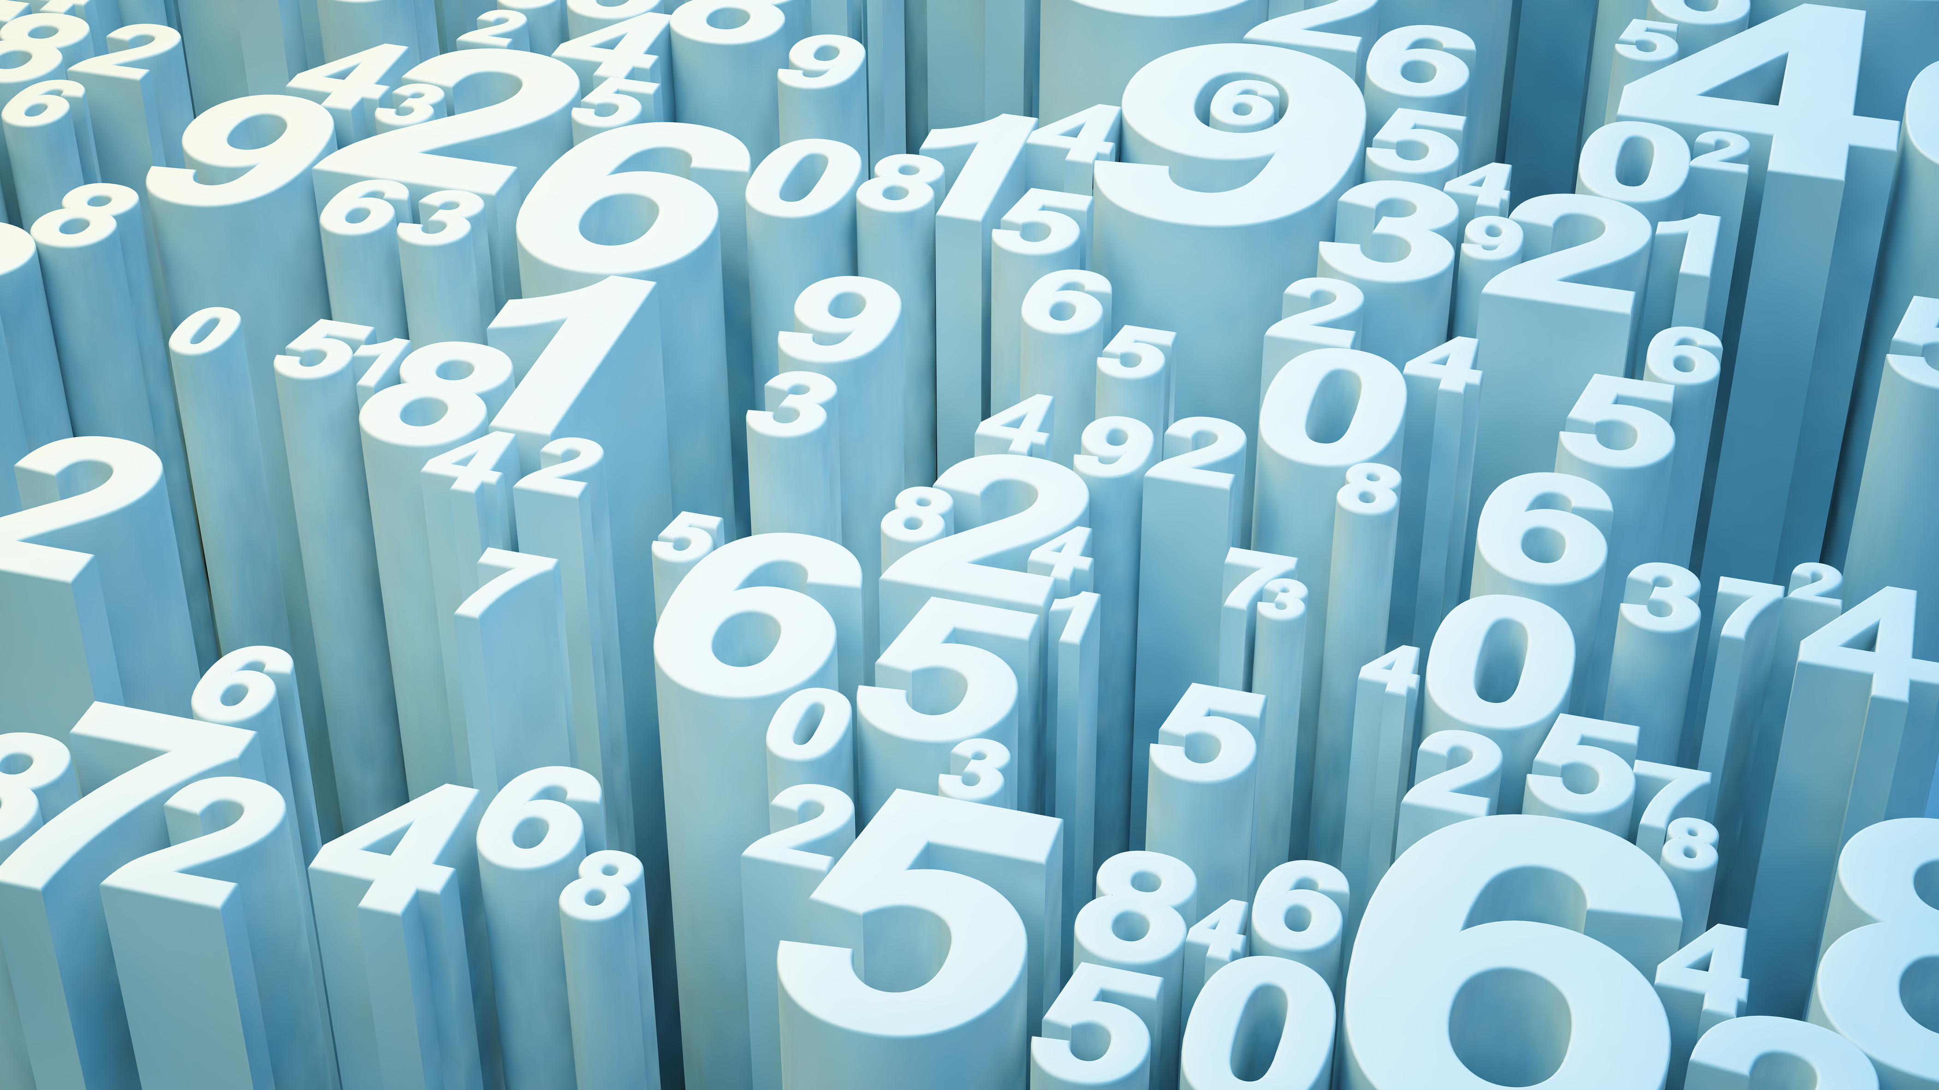
Musical Maths
By Alannah Hamilton

Slide 2
Similarities
You might be surprised but music is very much like maths.
Things they have in common are: In music as in maths problems are best solved by breaking it into parts and [ once solved ] put them back together to get the answer.
Repetition, in maths as in music there is repetition which is similar to times tables.
Once you know the basics, you apply this knowledge as things get more complicated .

Slide 3
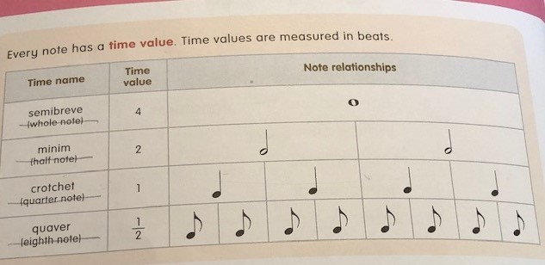
Fractions In Music
In music, notes are equal to numbers and get broken down into fractions.
As you can see in this diagram different combinations of notes can equal various beats.

Slide 4
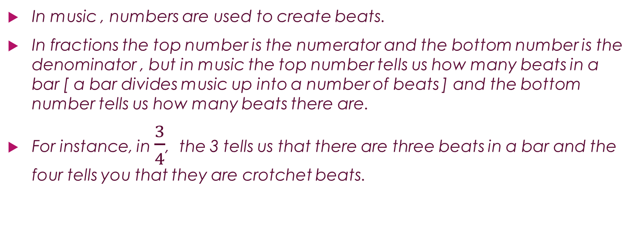
Time Signatures
In music , numbers are used to create beats.
In fractions the top number is the numerator and the bottom number is the denominator , but in music the top number tells us how many beats in a bar [ a bar divides music up into a number of beats ] and the bottom number tells us how many beats there are.
For instance, in $\frac{3}{4}$, the 3 tells us that there are three beats in a bar and the four tells you that they are crotchet beats.

Slide 5
Dots
[ it’s getting harder now ]
A dot after a note makes it longer by half it’s value : for example, a minim has a value of two beats. If you add a dot after it, it becomes a dotted minim and adds half it’s value which makes three beats. A difficult one –a quaver has half a beat. If you put a dot after it, you have to add a quarter and it becomes three quarters of a beat , a dotted quaver.

Slide 6
I hope you have learnt some thing today, some thing new. I enjoyed making this power point and hope you enjoyed it to. Thank you for reading my power point.
goodbye

